Slide 1
House of Cascading Style
Karen Niemla ULM Library
Notes:
First of all, I want to ask you-all, how many of you have heard of CSS before? ________ We're going to talk about:

Slide 2
•What are they?
•Why care about them?
•How to control them?
Notes:
Also hope to show you that this isn’t all too hard to do.

Slide 3
CSS
Notes:
CSS stands for ….

Slide 4
Cascading Style Sheet
Notes:
CSS stands for "Cascading Style Sheet."
Why have have to "casade" I don't know; probably because they are read from top to bottom? But I do know why they are called style sheets: because they give your web pages STYLE.

Slide 5
Cascading Style Sheet
Notes:
CSS as a language in itself is no real replacement for HTML and neither XML for that matter. It's just an bunch of text that tells your programs what to do.

Slide 6
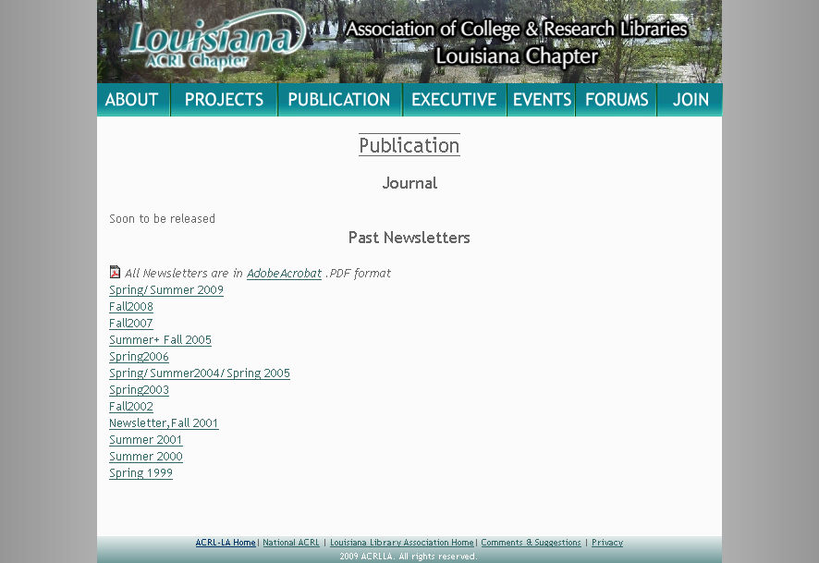
Notes:
Basically, this is how they work. Your HTML document, or sometimes PHP, or what ever have you, will look to this css template to figure out what it is supposed to look like.

Slide 7
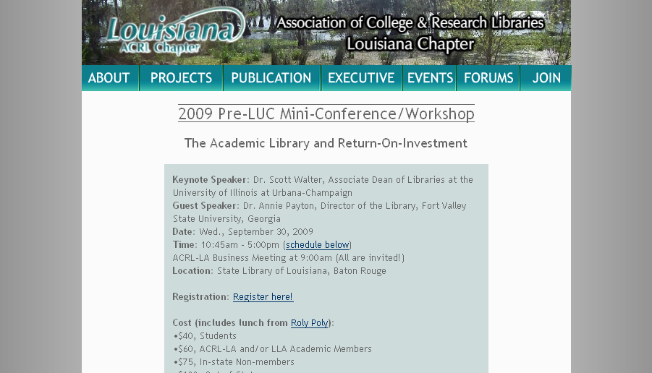
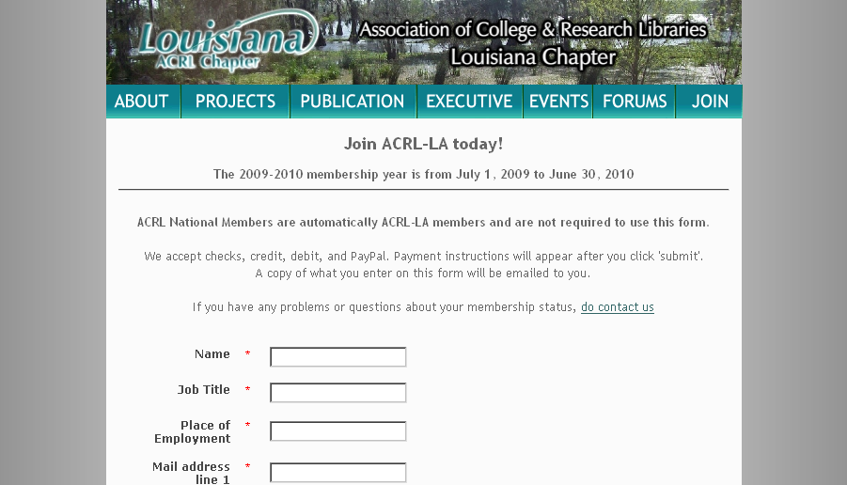
Notes:
And if you have more than one page, if they’re all reading the same CSS file they’ll all look the same. This is what you want. Otherwise, if I wanted to change a color, I’d have to do it on EVERY one. That’s a lot of pages.

Slide 8
Notes:
Then your browser will read them both and then display a page for you (and it really does matter what browser you're using, too). Different browsers read markup differently. This makes all design very hard.
I’ve asked these gentlemen to draw a cat. They both drew cats. But they’ve got their own ideas on how to do that.
I won’t get into it, but do expect this to be a problem in your adventures with CSS, or any web publishing of any kind, actually.

Slide 9
(kn1.css)
“Web 2.0”
boy howdy ,
yabba dabba doo…
Notes:
This is the separation of content from design. And this is an important part of what Web 2.0 is, and may in face be the only concrete defining trait of Web 2.0. However, CSS has been around since the 1990s, so treating it as something new isn't' entirely accurate. If you've ever heard me talk about Web 2.0 before, you know that I'm skeptical of its originality (but that's not why we're here today). Web 2.0 is known for fast exchange of lots of information, and separating content from design makes it easier to do that.

Slide 10
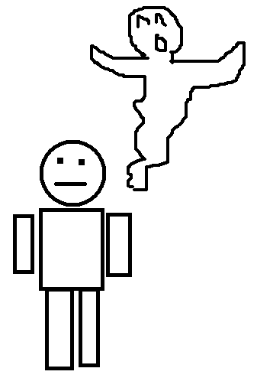
Notes:
See this guy? He's got information in his head, but he's just a guy. To get information out of him you have to read him, and talk to him. And that information is stuck in his head. The content is stuck in the design of his body. If he could project himself out of his body and become a ghost, he could possess bodies, and then people could get the information out a lot faster. And walk through walls. That's Web 2.0 design.

Slide 11
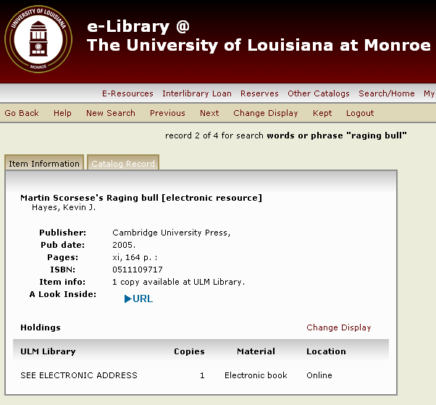
Notes:
And it's isn't a new concept. Libraries have been doing this since before I was born. You OPAC reads a bunch of MARC records you have, and then makes a record for your patron to read. But the record they see doesn't equal the MARC record. Those are kept safe somewhere else. SysrisDynix's E-library uses CSS language to some degree, and I'll explain how I did that later.

Slide 12
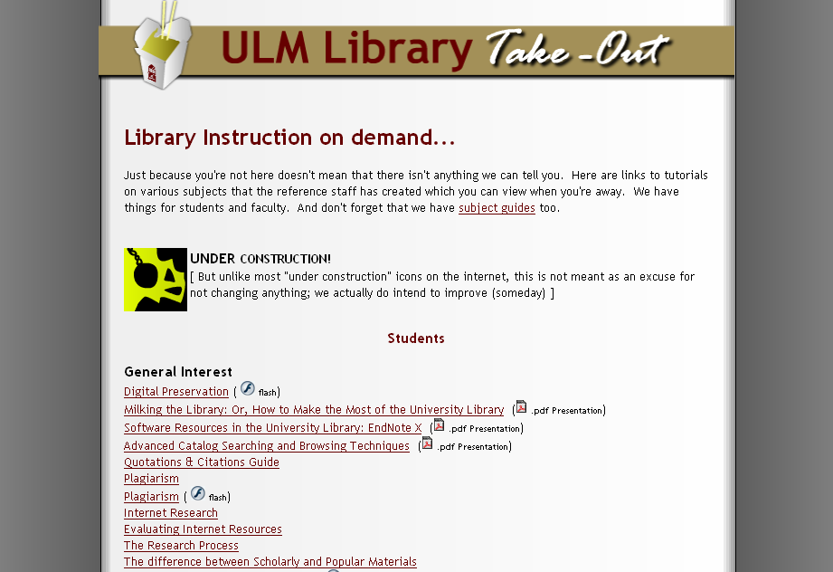
Notes:
It's not that new to the internet, too your regualr run-of-the mill stiffy McStifferson HTML file can have CSS inside. Somtimes the style sheets can go inside of an HTML document rather than be a seperate file. Fair enough; sometimes you don't want.to be keeping track of them all.
Here's a demo page I made a long time ago. I composed it in an HTML composer called SeaMonkey. I was able to do a lot in HTML by itself, but I couldn't get the background to work as I wanted it to. So I asked Google to find me someone who could tell me how to do the background how I wanted to.

Slide 13
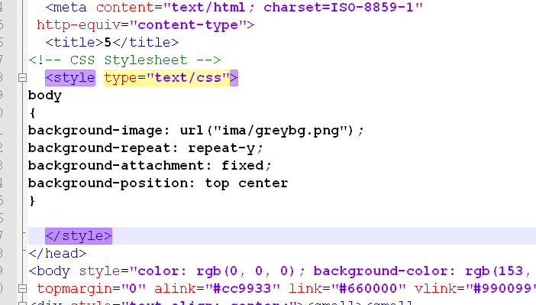
Notes:
This bit of CSS in it's source code that tells it how I want the background to look. What you see here is a small centered image that repeats downwards, and makes this grey background possible.
I should also mention that if you want to work on CSS, you will want to look into getting a good text editor like Notepad++/
See how the working park of the CSS has been highlighted for me? This is not helpful. This is crucial. Because if you try to do this in plain notepad, you might get something like this:

Slide 14
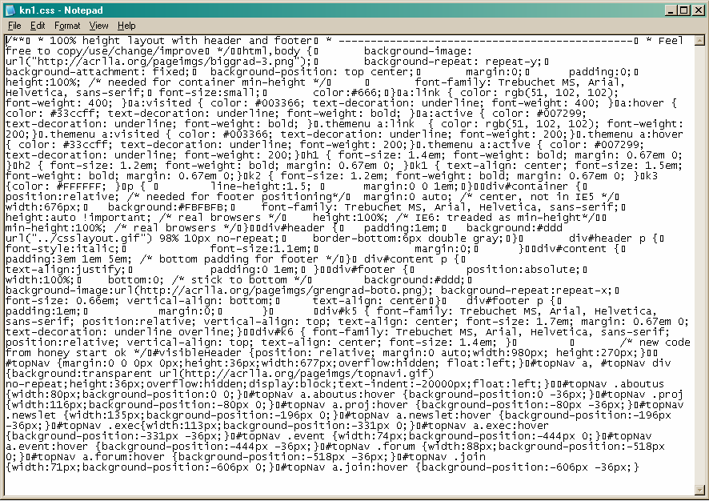
Notes:
It’s not always this bad, but if you text editor isn’t very smart, you really can’t do much of anything.

Slide 15
Notes:
So I highly recommend using Notepad++, which is open source and free to use. Some people think you need Dreamweaver to do this, and it has its purposes, but there's no reason to buy that when Notepad++ and others like it are out there. It is only text, but it is extremely powerful. My life wouldn't be the same without it. I use it for CSS, HTML, PHP, and TXT… just writing, even.
This is the primary tool I use to update ACRLLA .org and the ULM library site.

Slide 16
(whoa whoa whoa)
Notes:
But I'm not asking you to start from scratch. (whoa whoa whoa). I know that's you're all not ready for it yet. Maybe some of you are, I don't know.

Slide 17
Why?
Notes:
But... why got to all this trouble? What's the big deal, then? Why does it matter?

Slide 18
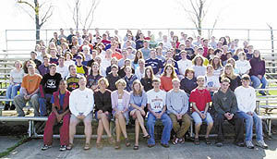
It’s High School all over again.
Notes:
Appearances are dreadfully important.
It's high school all over again on the internet. People judge you in a second. Before they even get to know who you really are. And you can't blame them, really. Web browsing is visual, unless you're blind of course, and CSS makes life easier for them, too, actually.

Slide 19
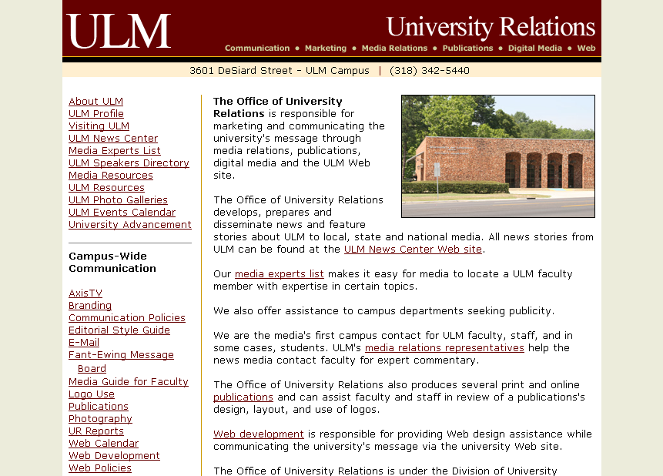
Notes:
Your university knows this. That’s why they have public relations. They do branding. You're a part of the product they are selling: education. You're a valuable part of that product. Never doubt it. They are thinking about these things, and you should too. But your patrons can find continuity helpful.

Slide 20
Notes:
Most blogs and other things like them have the template appearances that they come with. That’s fine. But your library is great. You should want more.

Slide 21
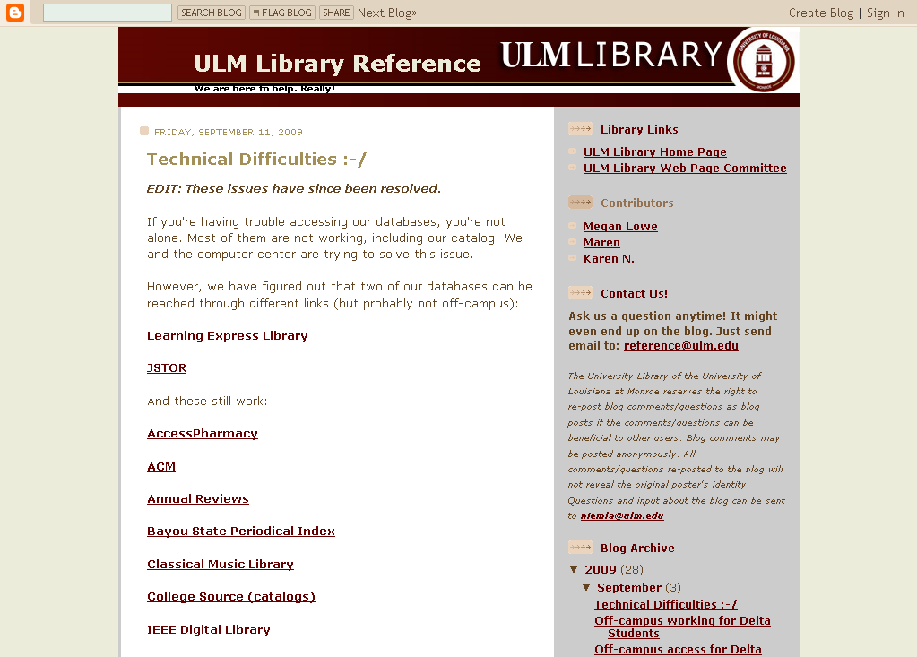
Notes:
Here’s an example from ULM’s Library web site. This is our blog. I made it from the same base template as this.

Slide 22
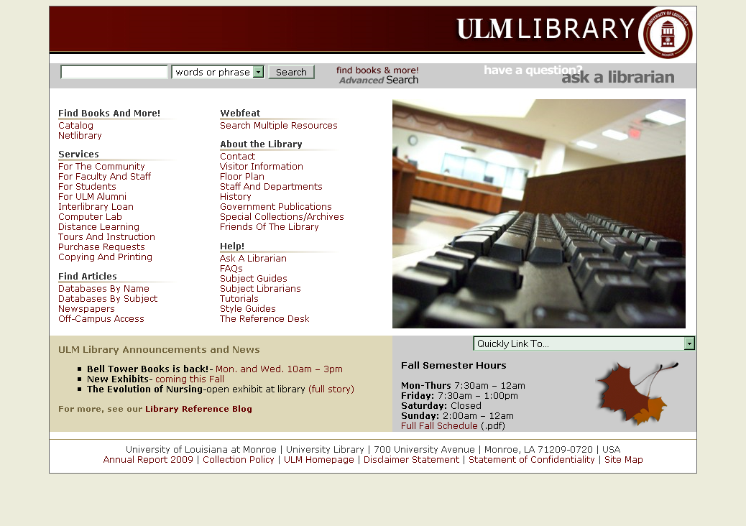
Notes:
This is our home page.

Slide 23
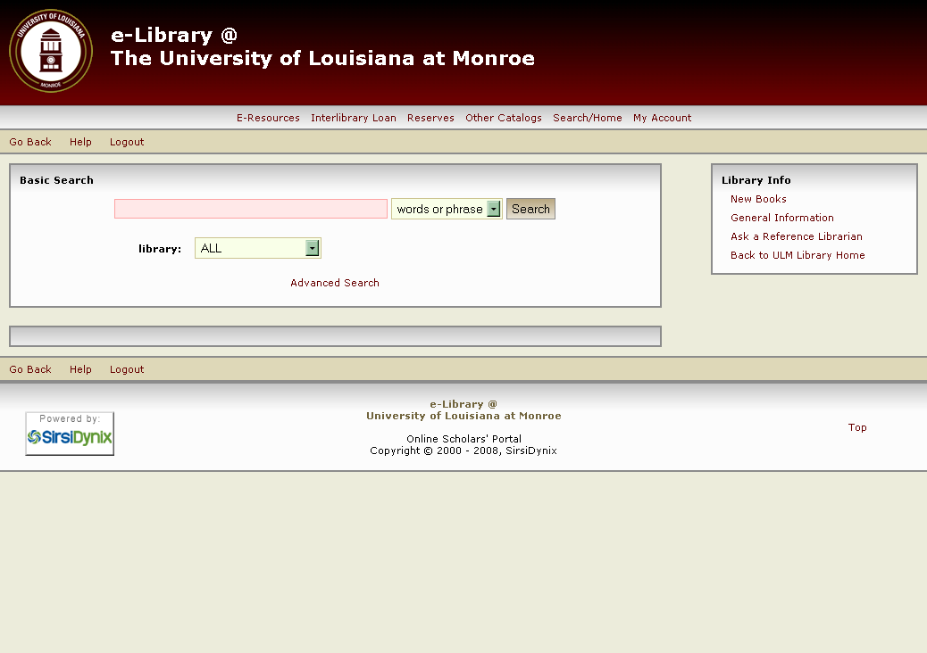
Notes:
This is our catalog.

Slide 24
Notes:
They’re not all exactly the same, but they’re all a little similar. I want our patrons to know that these are OURS, and without actually telling them that outright. I want the to FEEL that they’re related. You can do instruction to tell people what does what, but in a virtual environment you need to guide people digitally, make you presence know through that medium, and visual cues is one way you make that happen.

Slide 25
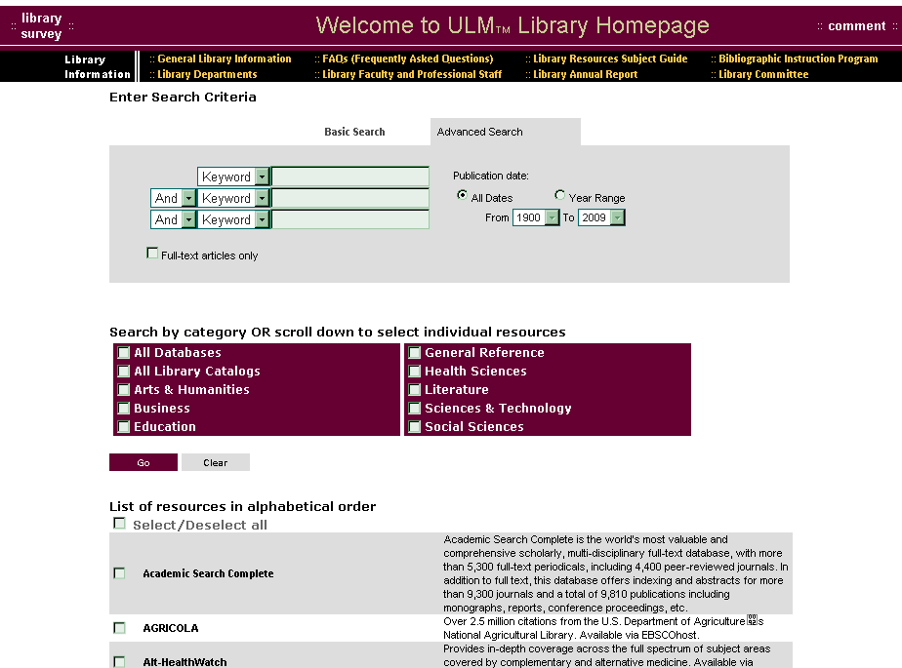
Notes:
Here's what happens when it's not working as well. The library was considering getting rid of Webfeat. So I didn't bother to fix up webfeat. But we changed our minds. Now I'm going to fix it. Now look at it. The maroon was never right. This thing is next.
It's also like grounds-keeping. Giving people a place they can be proud of. I’m not proud of this. But most of my reference cohorts ignore this thing also.

Slide 26
Notes:
Compared to the others, it’s not as sharp. But I’ll work on it and see what I can do. The whole purpose of doing this is making a Library site with components that are ULM’s library site, and to show patrons that we care. Because, as I said, it is high school all over again.

Slide 27
Make it your own
Notes:
Wouldn't you say that your catalog is the most important thing you have? That's your library's most important resource? Its unique to you because it's your unique library's being. Everything that you are it is. It's important. That being said, if it is so important to being unique, why is it that so many of them are the same? {CYCLE]

Slide 28
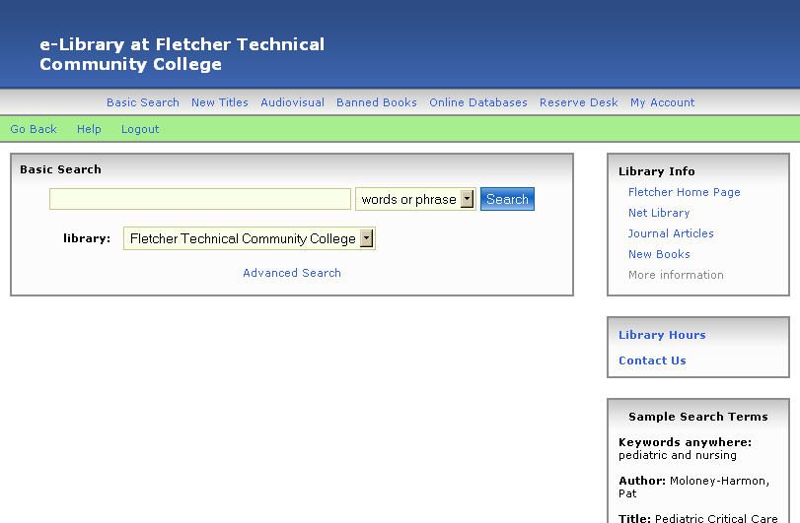
Notes:
Wouldn't you say that your catalog is the most important thing you have? That's your library's most important resource? Its unique to you because it's your unique library's being. Everything that you are it is. It's important. That being said, if it is so important to being unique, why is it that so many of them are the same? {CYCLE]

Slide 29
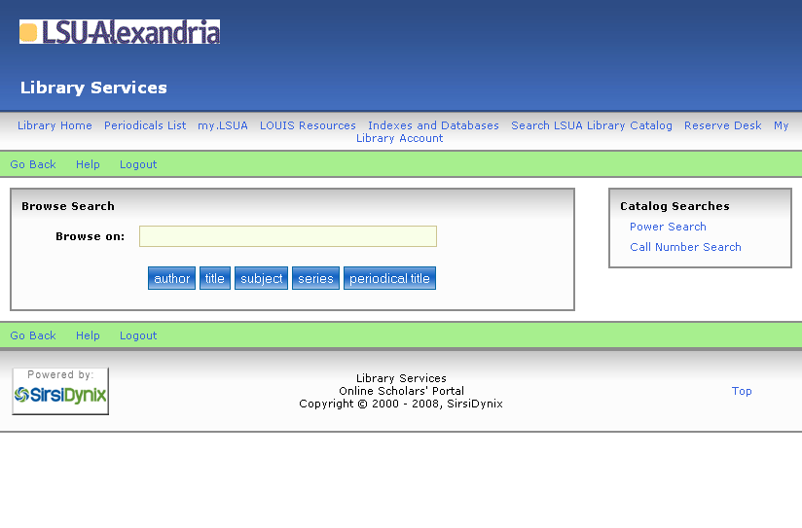
Notes:
Wouldn't you say that your catalog is the most important thing you have? That's your library's most important resource? Its unique to you because it's your unique library's being. Everything that you are it is. It's important. That being said, if it is so important to being unique, why is it that so many of them are the same? {CYCLE]

Slide 30
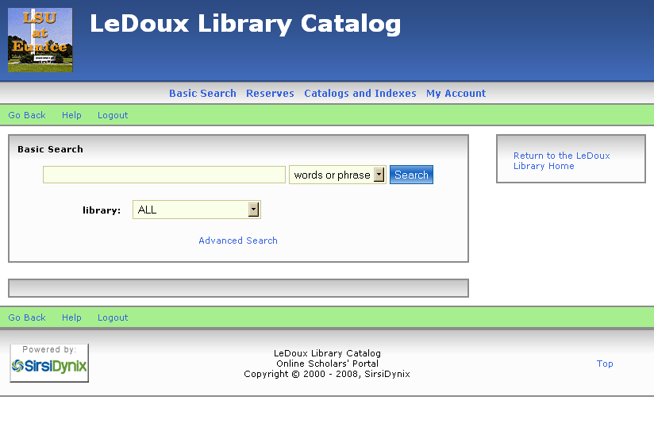
Notes:
Wouldn't you say that your catalog is the most important thing you have? That's your library's most important resource? Its unique to you because it's your unique library's being. Everything that you are it is. It's important. That being said, if it is so important to being unique, why is it that so many of them are the same? {CYCLE]

Slide 31
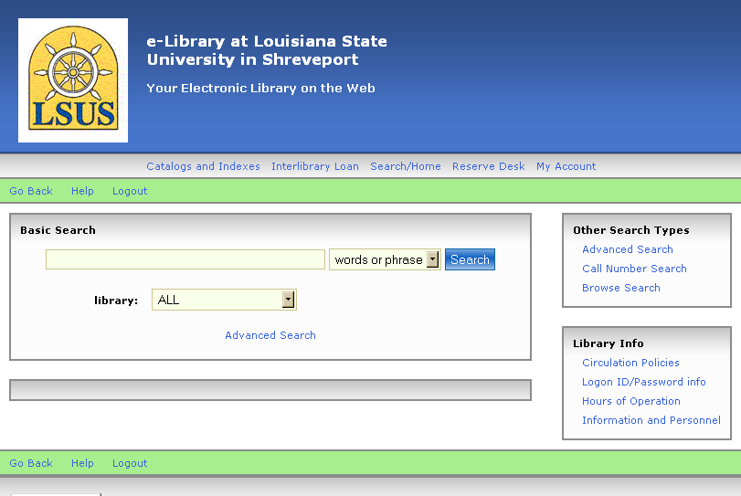
Notes:
Wouldn't you say that your catalog is the most important thing you have? That's your library's most important resource? Its unique to you because it's your unique library's being. Everything that you are it is. It's important. That being said, if it is so important to being unique, why is it that so many of them are the same? {CYCLE]

Slide 32
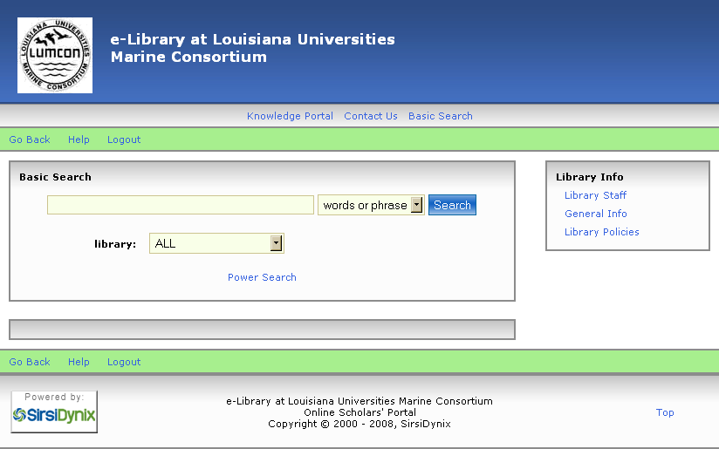
Notes:
Wouldn't you say that your catalog is the most important thing you have? That's your library's most important resource? Its unique to you because it's your unique library's being. Everything that you are it is. It's important. That being said, if it is so important to being unique, why is it that so many of them are the same? {CYCLE]

Slide 33
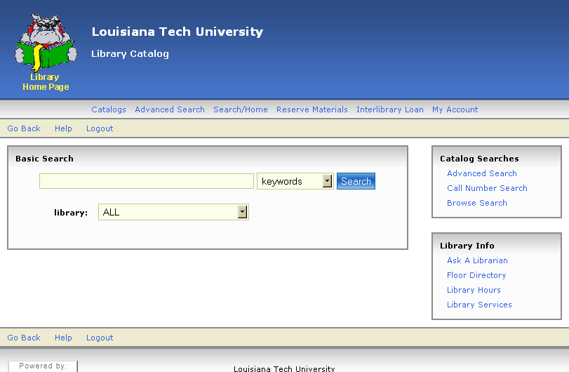
Notes:
Wouldn't you say that your catalog is the most important thing you have? That's your library's most important resource? Its unique to you because it's your unique library's being. Everything that you are it is. It's important. That being said, if it is so important to being unique, why is it that so many of them are the same? {CYCLE]

Slide 34
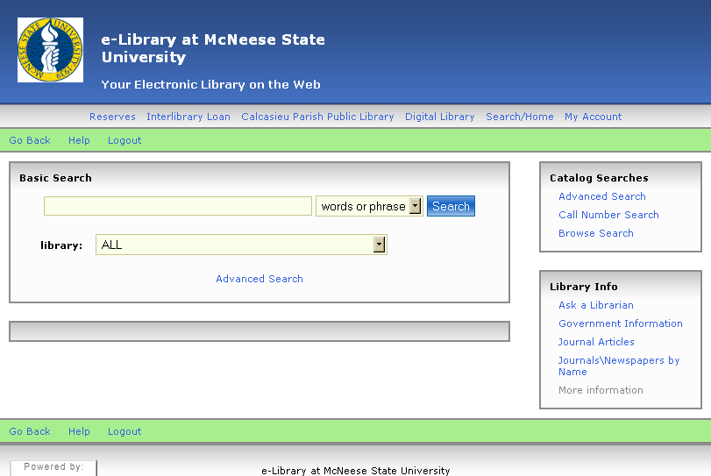
Notes:
Wouldn't you say that your catalog is the most important thing you have? That's your library's most important resource? Its unique to you because it's your unique library's being. Everything that you are it is. It's important. That being said, if it is so important to being unique, why is it that so many of them are the same? {CYCLE]

Slide 35
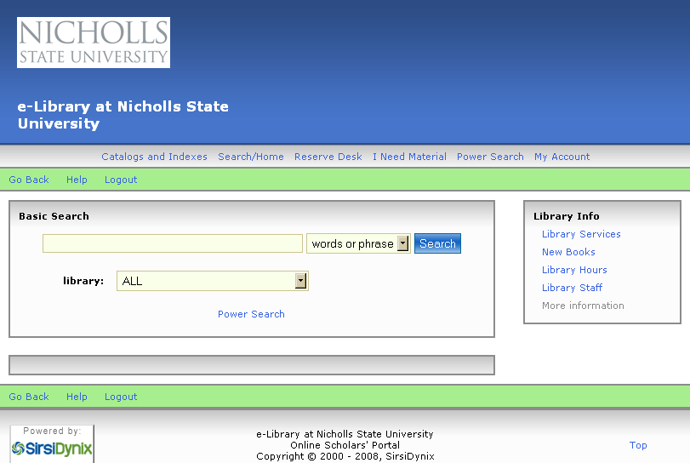
Notes:
Wouldn't you say that your catalog is the most important thing you have? That's your library's most important resource? Its unique to you because it's your unique library's being. Everything that you are it is. It's important. That being said, if it is so important to being unique, why is it that so many of them are the same? {CYCLE]

Slide 36
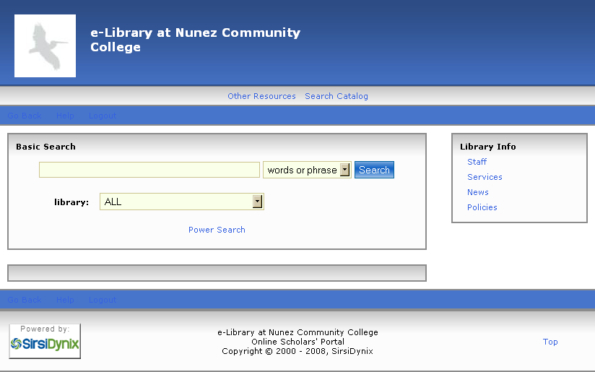
Notes:
Wouldn't you say that your catalog is the most important thing you have? That's your library's most important resource? Its unique to you because it's your unique library's being. Everything that you are it is. It's important. That being said, if it is so important to being unique, why is it that so many of them are the same? {CYCLE]

Slide 37
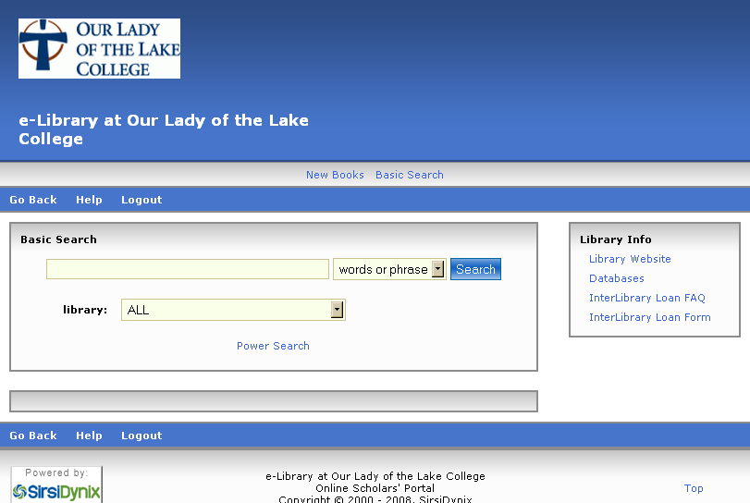
Notes:
Wouldn't you say that your catalog is the most important thing you have? That's your library's most important resource? Its unique to you because it's your unique library's being. Everything that you are it is. It's important. That being said, if it is so important to being unique, why is it that so many of them are the same? {CYCLE]

Slide 38
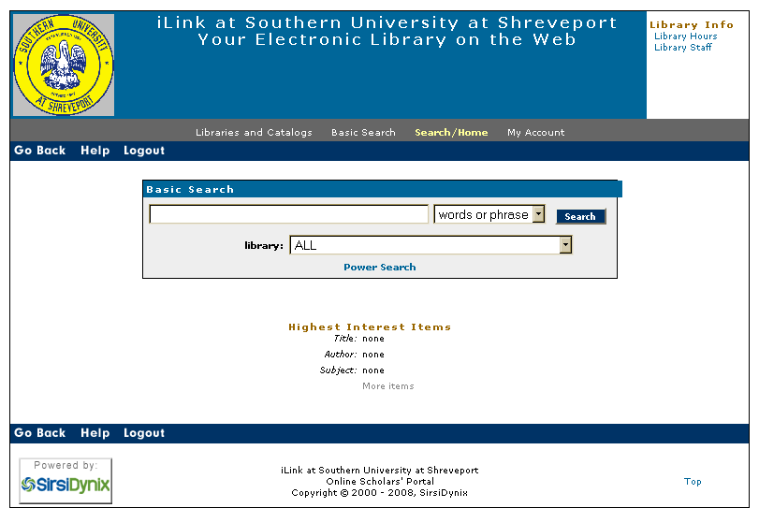
Notes:
Wouldn't you say that your catalog is the most important thing you have? That's your library's most important resource? Its unique to you because it's your unique library's being. Everything that you are it is. It's important. That being said, if it is so important to being unique, why is it that so many of them are the same? {CYCLE]

Slide 39
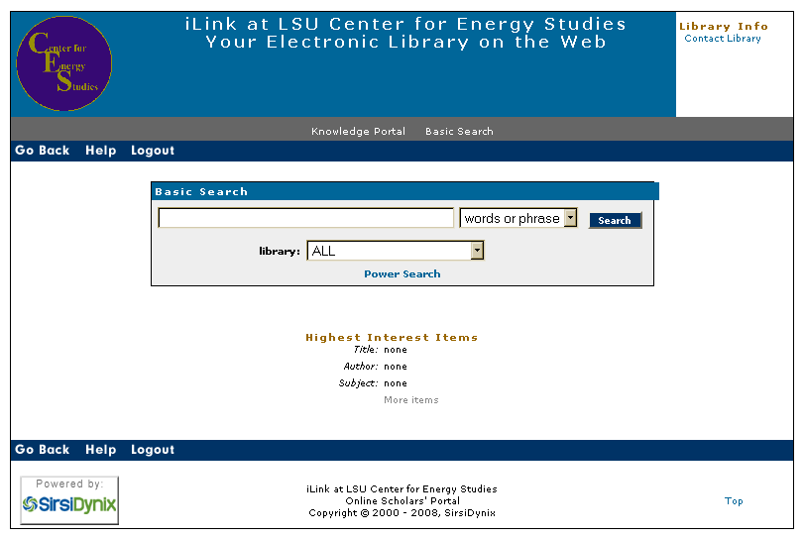
Notes:
Wouldn't you say that your catalog is the most important thing you have? That's your library's most important resource? Its unique to you because it's your unique library's being. Everything that you are it is. It's important. That being said, if it is so important to being unique, why is it that so many of them are the same? {CYCLE]

Slide 40
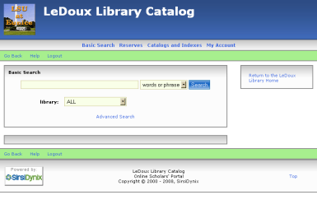
Notes:
I'm not saying that to be antagonistic at all, I'm just asking: If they're so important, why does one library's catalog look just like someone else's? I mean, we librarians know that they're all unique, but think about non-library people (aka normal people). What would you think if you looked at these? Sure all these catalogs are great but they're not saying to anyone "I'm special." But you are special. You just need to say so.

Slide 41
À Suivre!
Notes:
Your patrons should respect your catalog. If your catalog doesn't look and act like a modern web application, your patrons will not recognize it as a serious part of the website.
Ours looked like this before, following the old SyirsDynix product look. Some of your libraries still do. When we changed over to the new catalog, I made certain that the new catalog really looked like a brand new catalog, sending Mary L Stigall a million emails as I went along.

Slide 42
À Suivre!
Notes:
And this is it now. And I’ll tell you how…

Slide 43
It’s easy.

Slide 44
I cheated.
Notes:
But it's not really cheating. It's being resourceful.

Slide 45
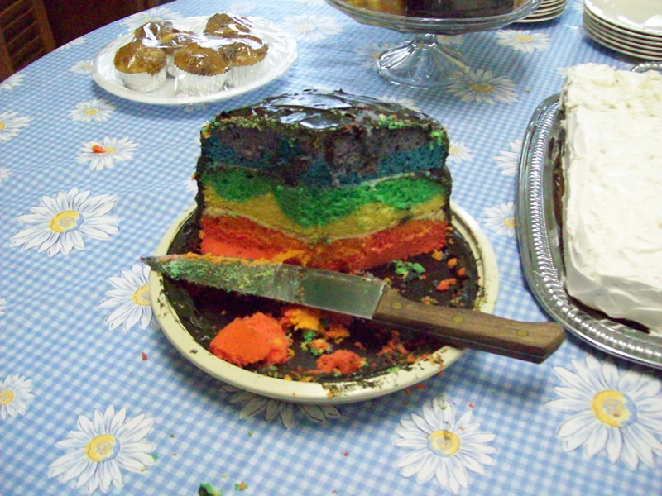
Notes:
I didn't make the cake from scratch. I made it from boxed mixes. But I could still make something out of it. It’s still good. So modifying a CSS template is like that. You take something already done for you, and make it yours.

Slide 46
Follow the directions on the box.
Most CSS expressions do what they say they will.
Notes:
But it's not really cheating. It's being resourceful.

Slide 47
Notes:
Remember this? Right now this probably looks like a bunch of mystery text to you. Just a lot of Greek. But it does make some sense. So let’s stop talking about it and actually try it.

Slide 48
• CSS Template
• text editor Notepad++ or another 'nice‘ one
• Imaging program, (GIMP, Microsoft Publisher, Paint, etc.)
• Time
Notes:
Here is what you'll need:
Ingredients:

